Slide 1
ALOR: Adaptive Layout Optimization of Raft Groups for Heterogeneous Distributed Key-Value Stores
Conference : NPC’18
Author : Yangyang Wang, Yunpeng Chai, Xin Wang
Research unit : Key Laboratory of Data Engineering and Knowledge Engineering

Slide 2
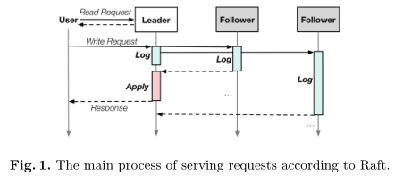
BackGround
Due to the excellent scalability and efficiency, key-value (KV) stores have been widely adopted by many big data systems.
Many distributed KV storage systems employ the Raft protocol to ensure data consistency because it is easy to be implemented in practical systems.
Notes:
由于其良好的可扩展性和效率，键值存储已被许多大数据系统广泛采用，许多分布式KV存储系统采用Raft协议来确保数据一致性，因为它易于在实际系统中实现。

Slide 3
BackGround
The leader in a Raft group usually takes more jobs and has greater impact on the performance than the followers do and is a performance bottleneck.
When workload demands overwhelm the leader, raft must expand outward.
Multi-Raft scales out by replicating leaders and followers, and splitting data between replicas. Each replica implements a Raft, providing strong consistency.
Notes:
筏群中的领导者通常比跟随者承担更多的工作，对表现的影响更大，是性能瓶颈。
当工作量需求压倒领导者时，raft必须向外扩展。
Multi-Raft通过复制leader和follower进行扩展，并在副本之间分割数据。每个副本实现一个Raft，提供强一致性。

Slide 4
BackGround

Slide 5
BackGround
Today’s distributed systems tend to be heterogeneous, especially for nodes’ I/O devices. The reason lies in the following two aspects:
The replacement rates of Solid State Drives (SSDs) are usually higher than disks due to the limited write endurance of Flash chips. The annual disk replacement rates in large-scale distributed systems are typically 2–4% and can be up to 13% in some systems.
The emerging storage devices (e.g., SSDs or non-volatile memory (NVM) ) have obvious performance advantages over the traditional ones. However, these new devices are usually much more expensive, so we usually deploy them in only a subset of the clusters for cost efficiency.
Notes:
今天的分布式系统往往是异构的，尤其是对于节点的I/O设备。原因在于以下两个方面：
闪存芯片的写入耐久性有限，固态驱动器（SSD）的更换率通常高于磁盘。大型分布式系统中的年度磁盘更换率通常为2-4%，在某些系统中可能高达13%。
新兴的存储设备（例如固态硬盘或非易失性存储器[3]）与传统设备相比具有明显的性能优势。然而，这些新设备通常要昂贵得多，因此为了节约成本，我们通常只将它们部署在集群的一个子集中。

Slide 6
Motivation
The Raft protocol has the inherent heterogeneous feature, i.e., the leader in a Raft group usually takes more jobs and has greater impact on the performance than the followers do.
If many leaders locate on slow nodes, the performance of the entire system will be slowed down, because the result is not returned to the client until the corresponding leader completes applying the log into the data set.
If we can adapt heterogeneity of Raft to the hardware heterogeneity of distributed KV systems through data layout optimization of Raft groups, the system performance can be improved.
Notes:
Raft协议具有固有的异构特性，即Raft组中的领导者通常比追随者承担更多的工作，对性能的影响更大。
如果许多领导者位于慢速节点上，整个系统的性能将降低，因为在相应领导者完成将日志应用到数据集中之前，结果不会返回给客户端
如果我们可以通过Raft组的数据布局优化，使Raft的异构性适应分布式KV系统的硬件异构性，则可以提高系统性能。

Slide 7
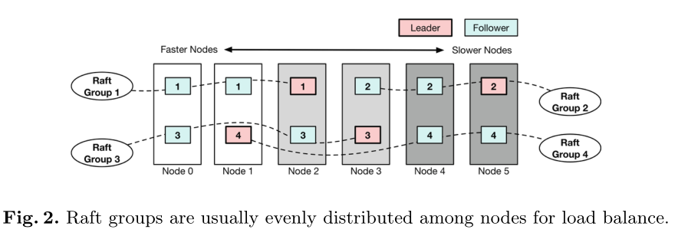
Leader Migration in Raft Groups
According to the Raft protocol, the performance of service nodes does not affect the leader election.
In this case, the leader and the followers in a Raft group are usually randomly and evenly distributed among all the service nodes for the sake of load balance no matter the underlying system is homogeneous or heterogeneous.
Notes:
根据Raft协议，服务节点的性能不影响领导选举。在这种情况下，无论底层系统是同质的还是异构的，筏群中的领导者和追随者通常随机均匀地分布在所有服务节点之间，以实现负载平衡。

Slide 8
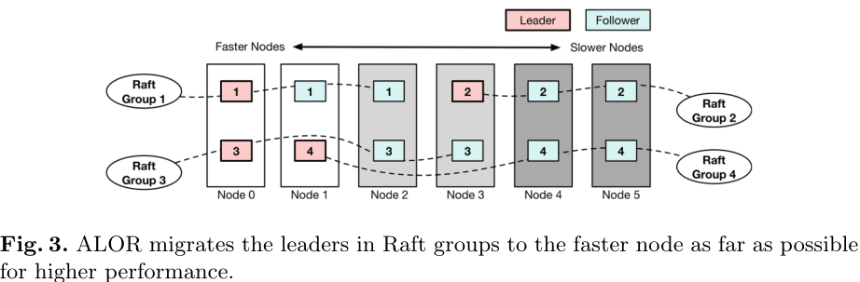
Leader Migration in Raft Groups
ALOR gradually migrates leaders to the node with the best performance in Raft groups. The larger the performance gap among the nodes in a Raft group is, the higher priority of migration the corresponding leader will be given in ALOR.
In fact, ALOR just fully utilizes the fast processing of high performance nodes in a heterogeneous system to reduce the process time of users’ write requests.
Notes:
ALOR逐渐将领导者迁移到Raft组中性能最佳的节点。Raft组中节点之间的性能差距越大，ALOR中相应领导者的迁移优先级越高
ALOR充分利用了异构系统中高性能节点的快速处理来减少用户写请求的处理时间。

Slide 9
Leader Migration in Raft Groups
Furthermore, as long as a follower catches up the same status of logging and applying data as the leader, it can be easily set as the new leader with negligible overhead.
Notes:
此外，只要跟随者赶上与引导者相同的记录和应用数据状态，就可以轻松地将其设置为新的引导者，开销可以忽略不计。

Slide 10
Skewed Data Layout Based on Cold Data Migration
The idea of promoting system performance in a heterogeneous distributed store is to put appropriate load on nodes according to their ability.
Although the aforementioned leader migration mechanism in ALOR puts more leaders on the strong nodes, this is not enough. We should further optimize the data amount distribution during the disk-filling process, i.e., putting more data on the high-performance nodes.
Notes:
在异构分布式存储中提高系统性能的想法是根据节点的能力对其施加适当的负载。
尽管上述ALOR中的先导迁移机制将更多先导放置在强节点上，但这还不够。我们应该在磁盘填充过程中进一步优化数据量分布，即在高性能节点上放置更多数据。

Slide 11
Skewed Data Layout Based on Cold Data Migration
However, it also causes two issues:
How to set an appropriate data-filling speeds according to the performance of a node?
How to process the new arrival data after some nodes are full is a problem.
Notes:
然而，它也引起了两个问题：（1）如何根据节点的性能设置适当的数据填充速度？
（2） 假设所有节点具有相同的存储容量，由于数据填充速度设置不同，一些高性能节点将比其他节点先满。因此，在一些节点已满后，如何处理新到达的数据是一个问题。以下部分将介绍ALOR中这两个问题的解决方案。

Slide 12
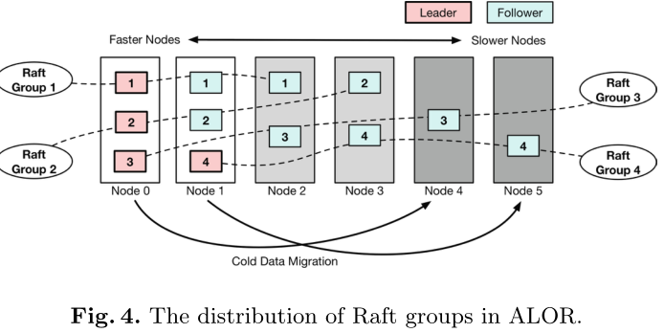
Disk-Filling Speed Setting
In ALOR, the disk-filling speed of nodes is set to be proportional to the average performance of writing key-value pairs into the KV store in the node.
Assuming there are six nodes and their KV accessing performance is 3:3:2:2:1:1, the proportion of data that they get is similar to this ratio. In this case, the load on a node matches its key-value pairs processing ability.
Notes:
在ALOR中，节点的磁盘填充速度设置为与将键值对写入节点中KV存储的平均性能成比例。
假设有六个节点，其KV访问性能为3:3:2:2:1:1，则它们获得的数据比例与此比例相似。在这种情况下，节点上的负载与其键值对处理能力相匹配

Slide 13
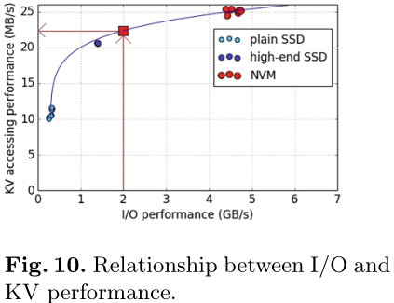
Disk-Filling Speed Setting
How to estimate the key-value accessing performance of the nodes?
The solution is to automatically measure the I/O performance of nodes during initialization by invoking tools such as FIO.
The I/O and KV performance of several representative nodes were measured and their relationships were constructed in advance.
Then, the KV performance of the node can be fitted by the measured I/O performance
Notes:
下一个问题是如何估计节点的键值访问性能。难点在于分布式键值存储通常不在单个节点上提供KV访问接口。
我们的解决方案是通过调用fio等工具[23]，在初始化过程中自动测量节点的I/O性能。然而，I/O性能与节点的KV访问性能不是线性的。因此，我们测量了几个代表性节点的I/O和KV性能，并事先构建了它们的关系。然后，我们可以通过测量的I/O性能来拟合节点的KV性能。

Slide 14
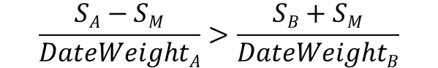
Cold Data Migration.
When the data volume of a node reaches a specified threshold (e.g., 95% of its capacity), we need to migrate some cold data in this node to others, thus making room for the new arrivals. The node’s data weight will be set to a very small value (e.g., 10−6), some of its cold data will be migrated to other nodes.
The condition of migrating some data in node A to node B can be expressed as Eq.
S_{A} and S_{B} are the data volume of node A and B respectively
DataWeight is employed to control the data migration among nodes
$$\frac{SA−SM}{DateWeightA}>\frac{SB+SM}{DateWeightB}$$
Notes:
当节点的数据量达到指定阈值（例如，其容量的95%）时，我们需要将该节点中的一些冷数据迁移到其他节点，从而为新到达的数据腾出空间。
然后节点的数据权重将设置为非常小的值（例如10−6） ，它的一些冷数据将迁移到其他节点

Slide 15
Cold Data Migration
The advantage of the cold data migration mechanism in ALOR is to promote the hotness of the stored data in high-performance nodes, whose side-effect lies in the additional overhead of data migration among nodes.
Notes:
ALOR中冷数据迁移机制的优点是提高高性能节点（例如，图4中的节点0）中存储数据的热性，其副作用在于节点之间数据迁移的额外开销。

Slide 16
Evaluation
Eight physical nodes, six of the nodes serve as TiKV node, one node as PD, and one node runs the benchmark tool, i.e., go-YCSB.
One node equips the fastest NVM block device, two node equip the high-end SSDs, and the slowest plain SSDs are deployed in the other three nodes.
Each of them is coupled with Linux Centos 7 3.10.0, 16 GB DRAM and a 16-GB non-volatile memory (NVM) block device, where NVM is emulated by DRAM.
The workloads include Load (insert-only), Workload A (50:50 read/update), Workload B (95:5 read/update), and Workload C (read-only) of YCSB. Each key-value pair contains a 16-B key and a 1-KB value.
Firstly load 10 GB of data to fill the cluster (i.e., 30 GB data considering the replicas), and then perform workloads A, B, and C, respectively, accessing 10 GB of data each.

Slide 17
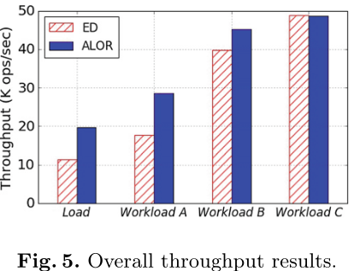
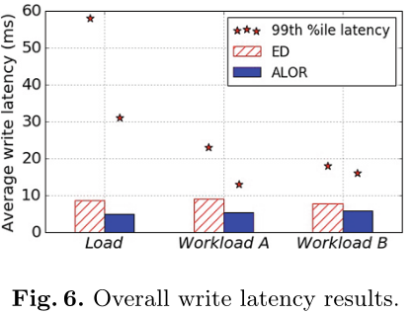
Evaluation
Overall Result
ALOR achieves higher throughput than ED in most cases, i.e., 72.6% higher in Load, 61.5% higher in Workload A, and 13.7% higher in Workload B.
One average, ALOR reduces the latency by 24.54% compared with ED.

Slide 18
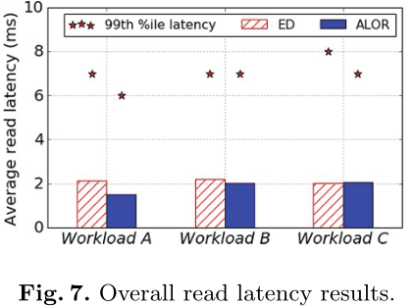
Evaluation
Overall Result
For both read and write operations, ALOR reduces the tail latency, i.e., 21.32% on average compared with ED.

Slide 19
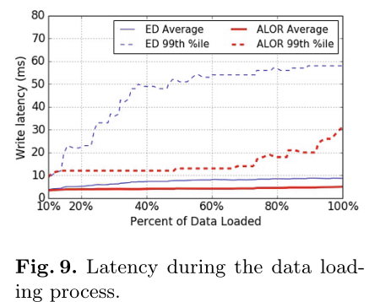
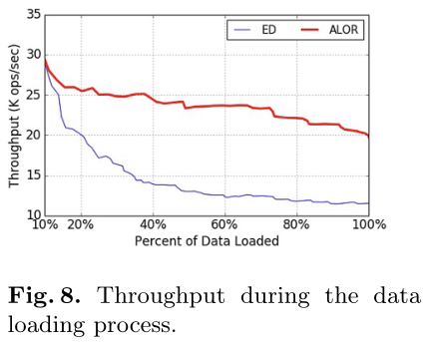
Evaluation
Overall Result

Slide 20
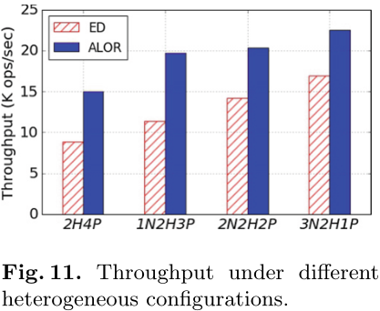
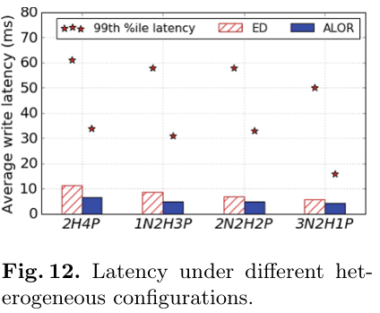
Evaluation
Impacts of Different Heterogeneous Configurations

Slide 21
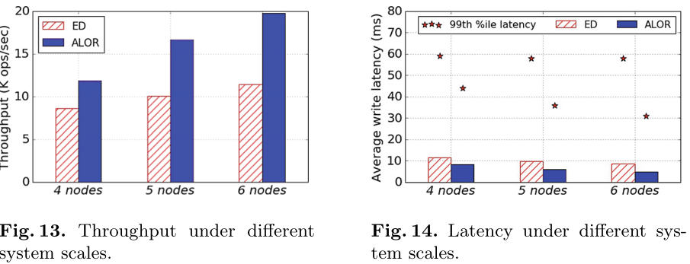
Evaluation
Impacts of System Scale
The configuration of the 4 TiKV nodes is one high-end SSD and three plain SSDs, that of the 5 TiKV nodes is one NVM block device, one high-end SSD, and three plain SSDs, and the configuration of the 6 TiKV nodes is one NVM block device, two high-end SSDs, and three plain SSDs.
For the 6 TiKV nodes, we wrote 10 GB data into the cluster; proportionally, we wrote 8.33 GB data into the 5 TiKV nodes, and 6.67 GB data into the 4 TiKV nodes.

Slide 22
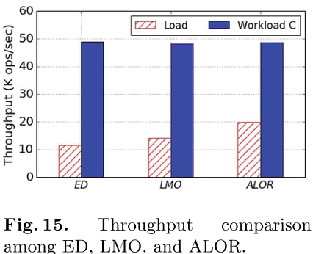
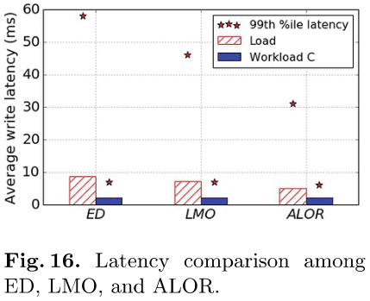
Evaluation
Analysis of ALOR Components
The experimental results show that the load performance of LMO is 22.85% higher than ED and ALOR is 40.53% higher than LMO. That means within the 72.64% throughput improvement of ALOR compared with ED, the leader migration module contributes about 31.45% of it, while the skewed data layout contributes about 68.55%.

Slide 23
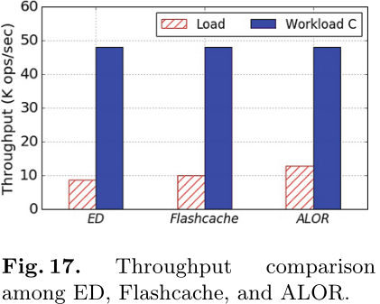
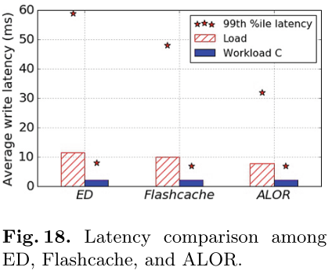
Evaluation
ALOR vs. Homogeneous Hybrid Device Solution

Slide 24
Conclusion
In this section, we conclude this paper with a summary of our contributions:
We found and verified that by matching the inherent heterogeneity of Raft groups and the hardware heterogeneity of distributed key-value stores, the system performance could be promoted.
We proposed a new optimized data layout scheme called ALOR, which achieves an appropriate layout of data and Raft leaders in a heterogeneous distributed key-value storage system through the leader migration and the skewed data layout mechanisms.
The experiments based on a practical heterogeneous cluster indicate that ALOR can promote the write throughput by up to 72.6% than the even data distribution solution, while achieving similar read performance.

